Slide 1
ENGINEERING EXPLORATION
ENGINEERING PROJECTS IN SOLVING CAMPUS PROBLEMS
(EPIP)
GUIDE NAME- TEAM NO – 8
Ms. GULSHAN RAJAT GUPTA(1710991638)
RITIKA BANSAL(1710991665)
RAGHAV GOEL(1710991616)
PRATHAM KAUSHAL(1710991587)

Slide 2
NEED STATEMENT
AUTOMATIC SHOE SHINNER
TO BE DRESSED IN A PROPER MANNER IS PROFESSIONAL REQUIREMENT OF A WELL GROMMED STUDENT. SHOES HAPPEN TO BE AN IMPORTANT COMPONENT OF WHOLE ATTIRE. DESIGN A LOW COST SHOE SHINNING MACHINE WHICH CAN BE INSTALLED AT VARIOUS PLACES IN THE CAMPUS AND CAN BE USED BY STUDENTS AT WILL..

Slide 3
PROBLEM STATEMENT
WE HAVE TO DESIGN AN AUTOMATIC SHOE SHINNER MACHINE. THE MAIN OBJECTIVE OF THE MACHINE IS TO REDUCE HUMAN EFFORST AND TO IMPROVE QUALITY OF POLISHING THE SHOE. IT IS A USER FRIENDY MACHINE AND MADE UP OF NON TOXIC MATERIALS. THE MACHINE WEIGHT LIES IN BETWEEN 5-6 KG AND IT WILL COST NEAR ABOUT 2000/-. IT IS PORTABLE MACHINE AND WILL BE EASY TO INSTALL IN HOMES, OFFICES AND COLLEGE CAMPUS. USAGE OF ROTATORY MOTOR WILL ENSURE PROPER CLEANING.
IT IS IDEAL FOR DIRT CLEANING AND POLISHING OF FORMAL BLACK SHOES. IT IS EASY TO INSTAL AND SAFE FOR ALL AGE GROUP OF PEOPLE. IT IS POWER EFFICIENT MACHINE AND WILL LAST LONG WITH LITTLE MAINTAINCE.

Slide 4
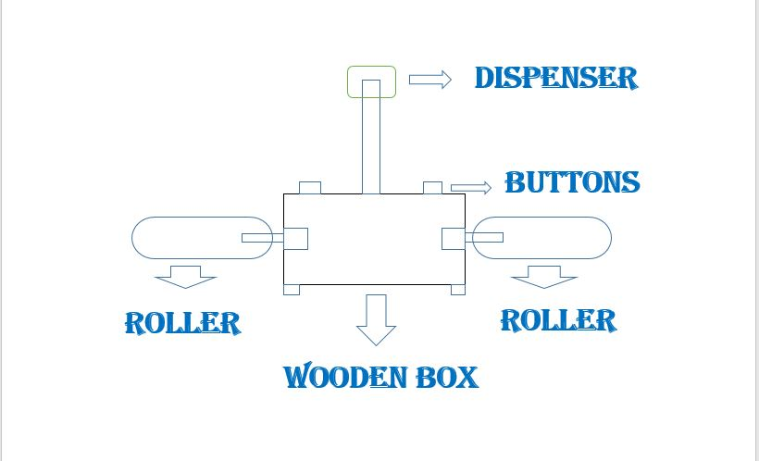
ENGINEERING DESIGN
FINAL DESIGN

Slide 5
MECHANISM
VOLUME OF BOX –
LENGTH – 9 Inch
BREATH – 5 Inch
HEIGTH – 5 Inch
MACHINE OCCUPY A CUBODIAL VOLUME OF – 225 (inch)3
MATERIAL –
PRIMARY MATERIAL USED IS - ‘WOOD’
POWER INPUT –
USING 12V 2 DC SUPPLIES.

Slide 6
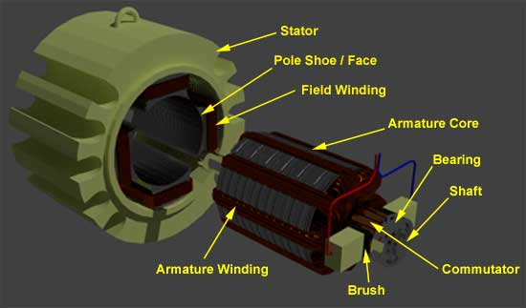
MECHANISM
ROTATORY MECHANISM -
WHEN CURRENT CARRYING CONDUCTOR IS PLACED IN
MAGNETIC FIELD, CONDUCTOR EXPERIENCES THE FORCE AND THIS FORCE LET THE SHAFT OF CONDUCTOR TO MOVE!

Slide 7
MECHANISM
POLISHING BRUSH –
BRUSH IS MADE UP OF FOAM AND
IN SHAPE OF CYCLINDER.
AREA OF POLISHING BRUSH –
RADIUS – 1.5 cm
HEIGTH – 16 cm
AREA - 2πrh
AREA – (2*3.14*1.5*16)
AREA – 150.72 (cm)2

Slide 8
platform based development
DC MOTOR -
12V DC MOTOR
200 RPM
2 mm REAR ENCODER SHAFT
WEIGHT – 159 g
LENGTH OF SHAFT – 16 mm
ARDUINO UNO -
WE HAVE USED ‘Arduino Uno’ BOARD.
BY USING C LANGUAGE AND ARDUINO BOARD WE CAN CONTROL SPEED OF MOTOR AND CHANGE THE DIRECTION IN CLOCKWISE

Slide 9
platform based development
AND ANTICLOCKWISE DIRECTION. IT HAS
16 DIGITAL PINS AND 8 ANALOG PINS.
MOTOR DRIVER –
WE HAVE USED ‘L298N’ MOTOR DRIVER.
DUAL H-BRIDGE
SPEED CONTROL
DIRECTION CONTROL
DC VOLTAGE 5-35V
PEAK CURRENT – 2A

Slide 10
COMPONENTS AND ITS COST
S.NO | COMPONENTS | COST
1. | ARDUINO UNO | 450/-
2. | WOODEN BOX | 350/-
3. | 200 RPM 2 DC MOTORS | 300/-
4. | RUBBER FORM | 200/-
5. | L298N H-BRIDGE | 150/-
6. | 9V 2 DC BATTERIES | 50/-
7. | OTHERS | 200/-
TOTAL | 1750/-

Slide 11
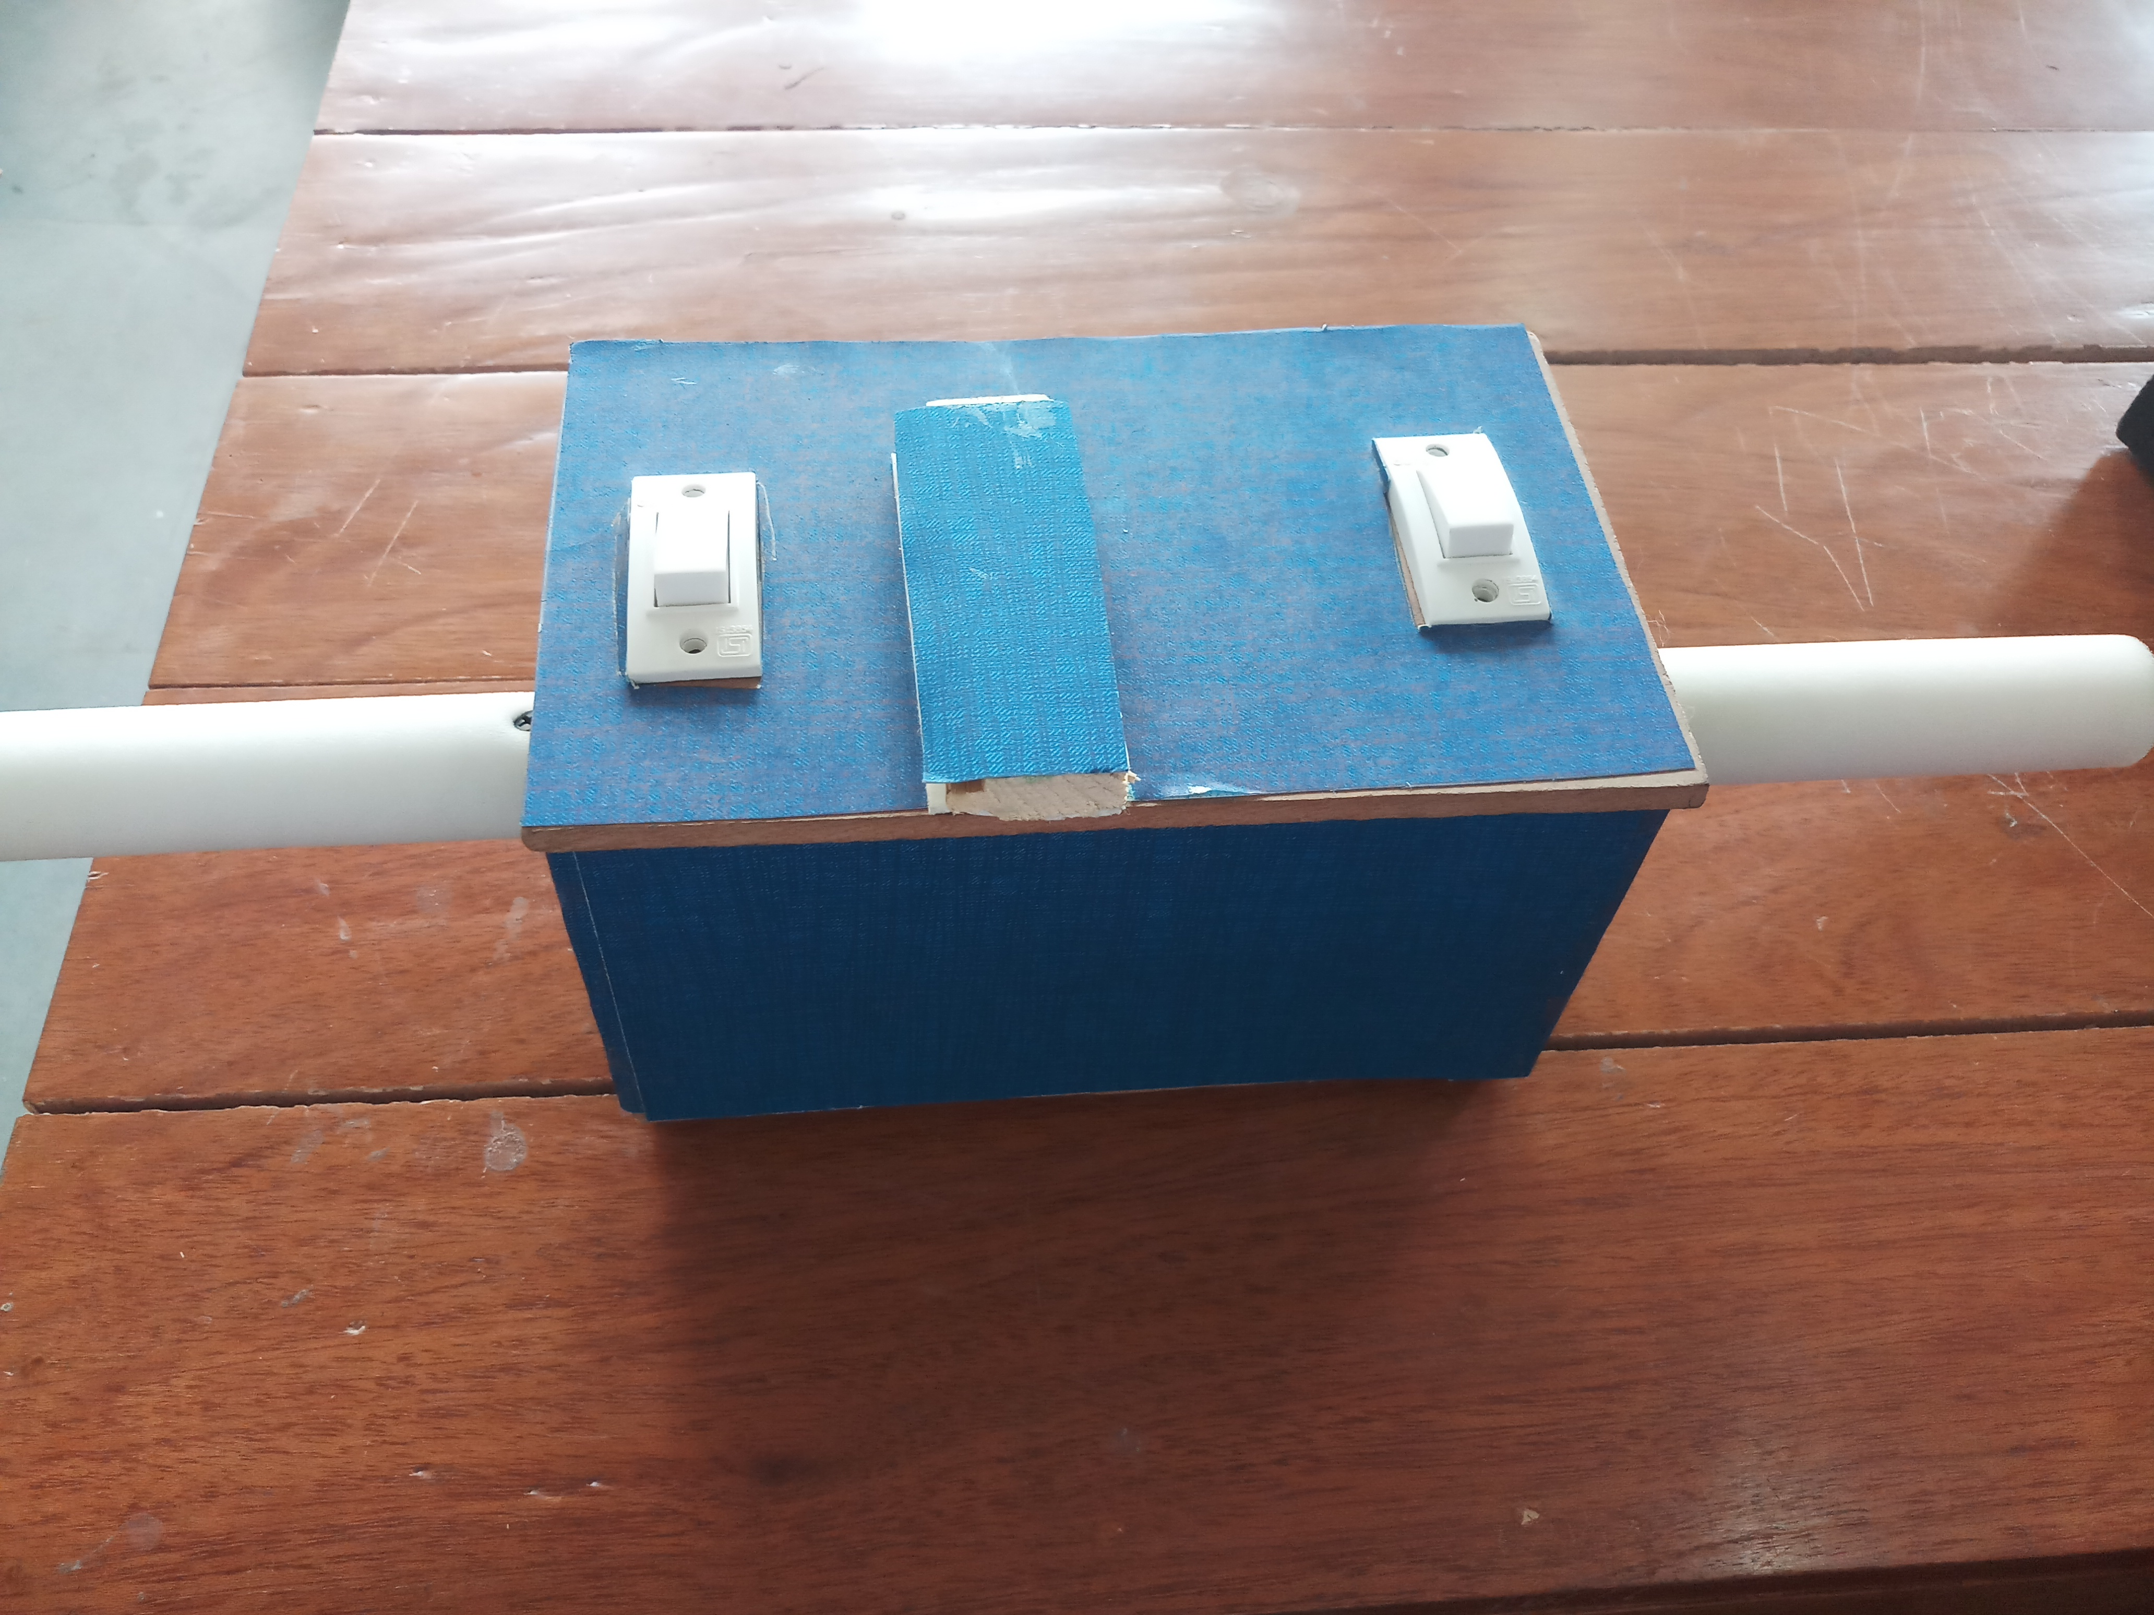
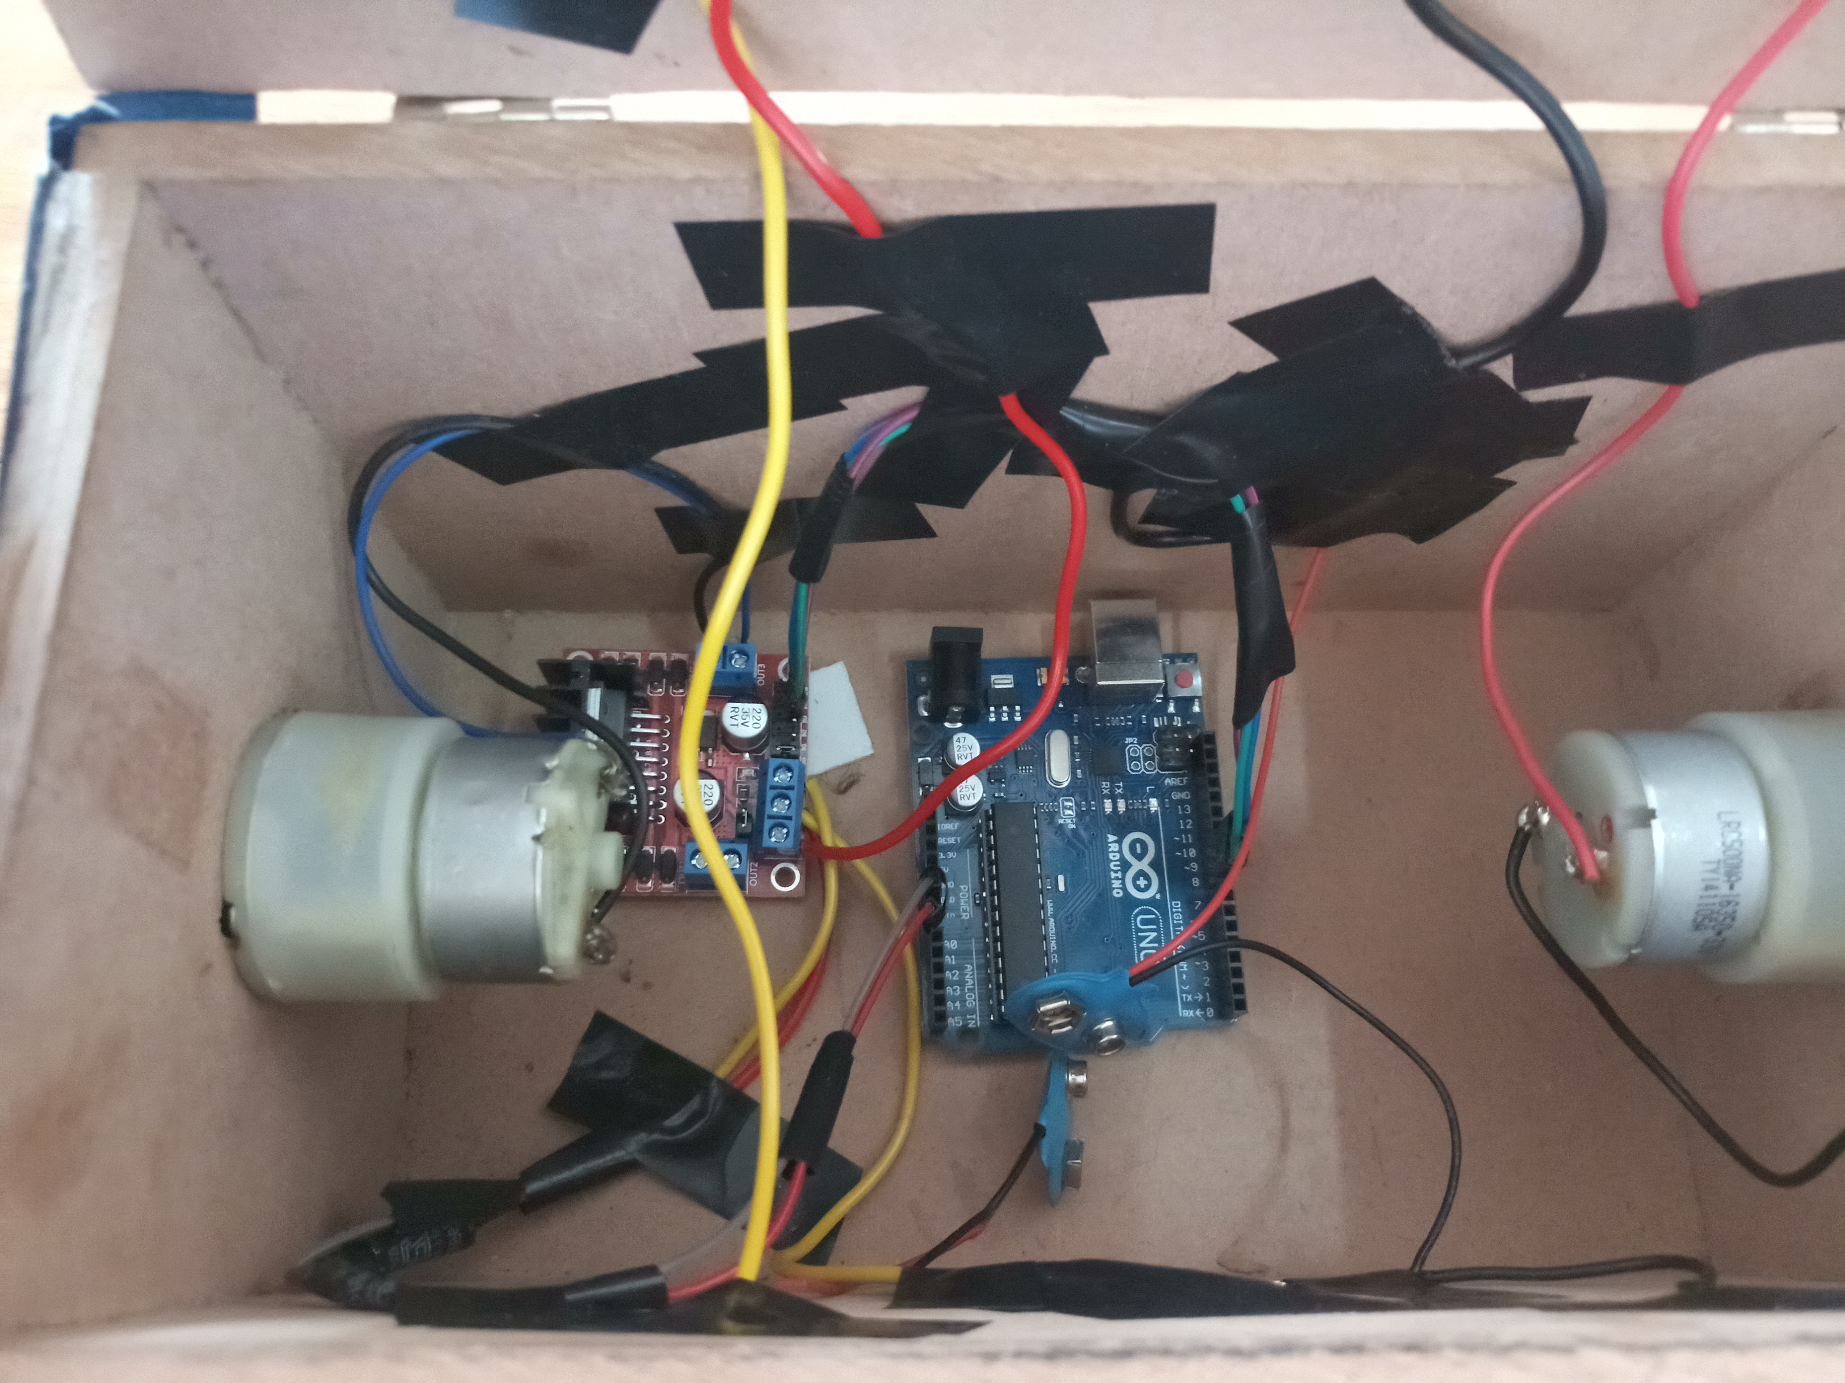
PICS/VIDEOS OF PROJECT

Slide 12
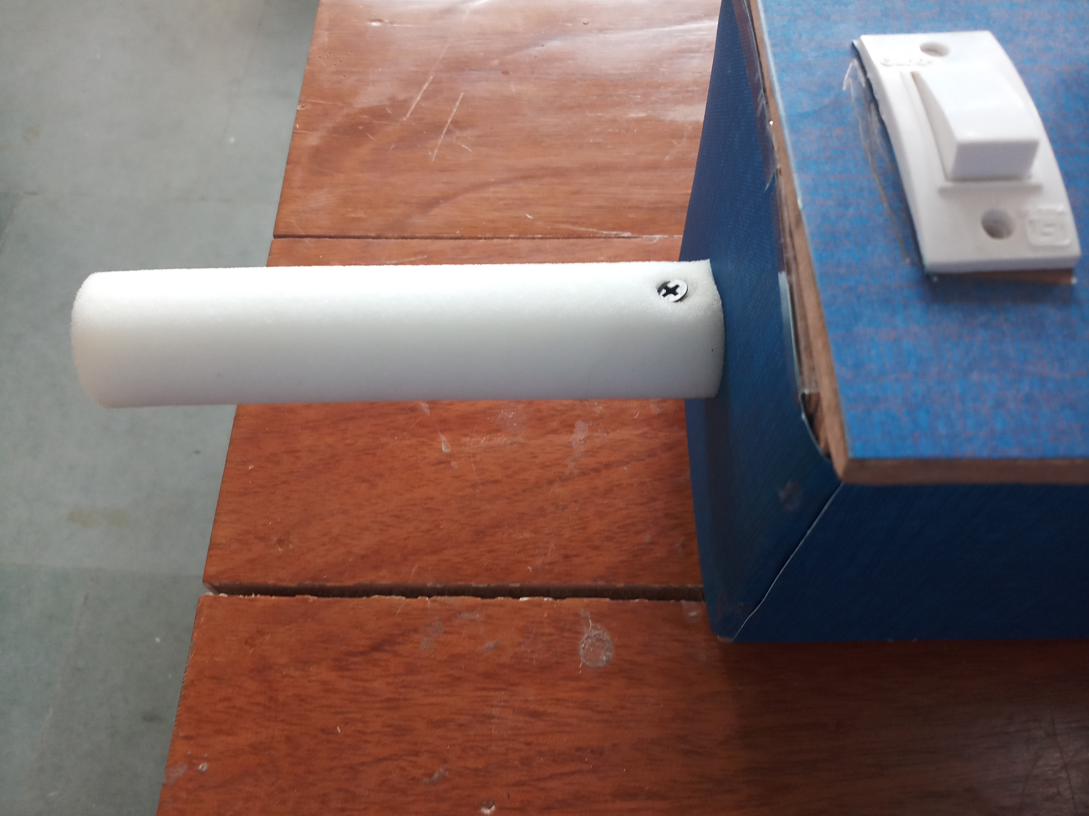
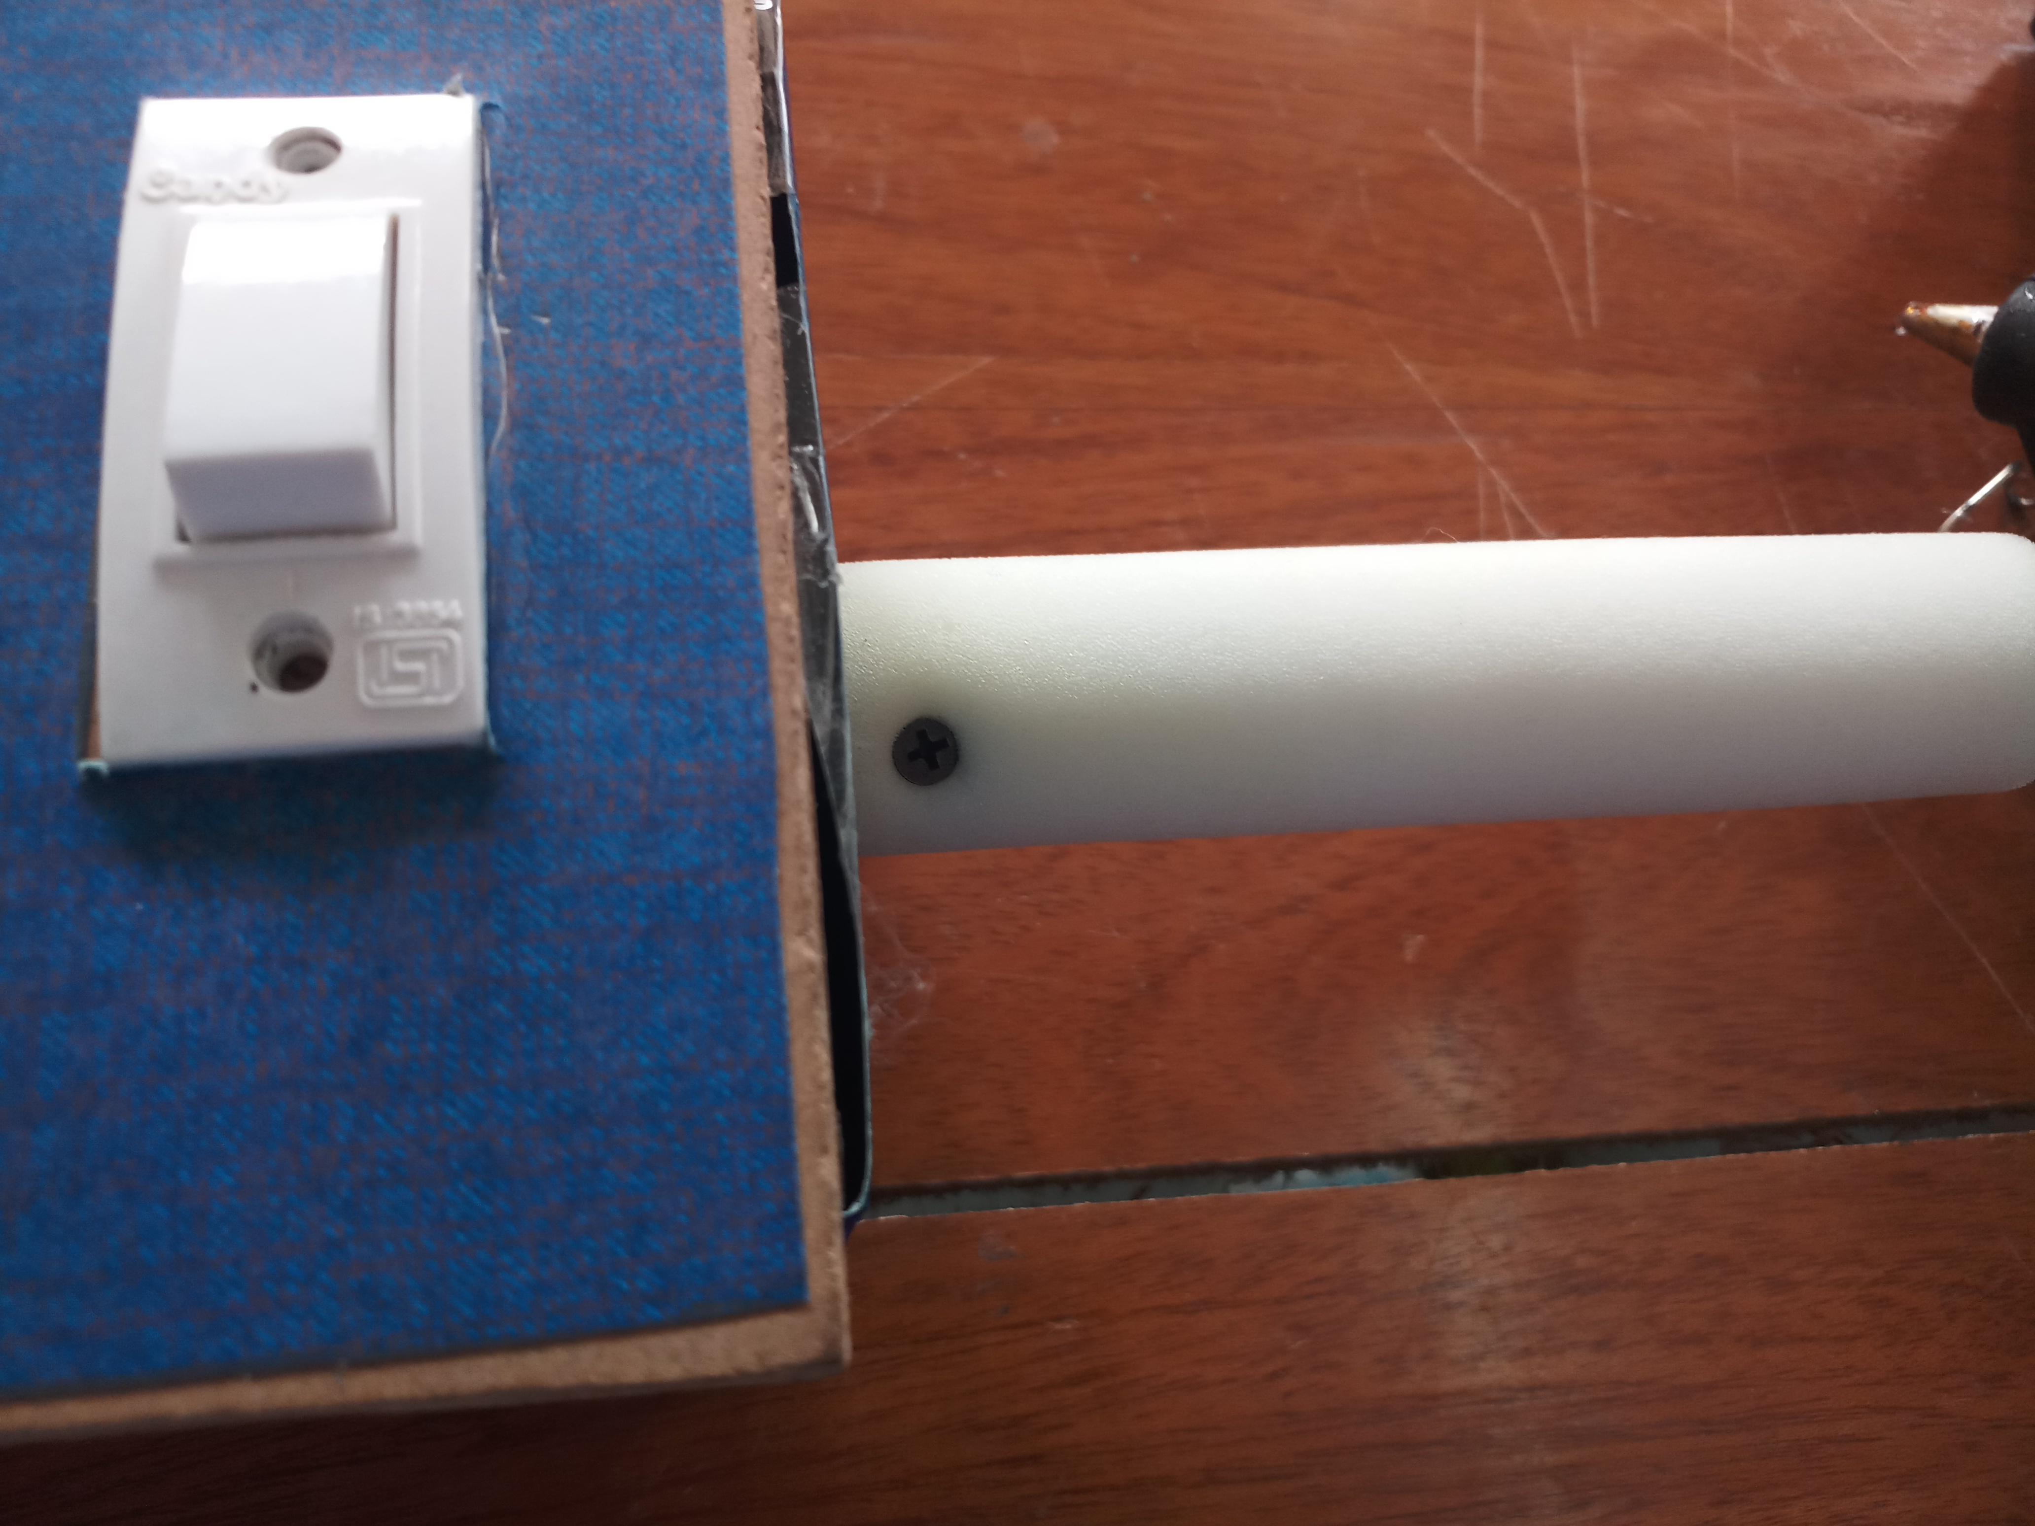
PICS/VIDEOS OF PROJECT

Slide 13
REFRENCES
www.dolphy.in/automatic-shoe-shining-machine-silver.html
https://www.amazon.in/Avro-Steel-Finish-Automatic-Machine/dp/B00KOLY7O0
https://irjet.net/archives/V4/i7/IRJET-V4I749.pdf
https://www.youtube.com/watch?v=PAsr8fKXAJA

Slide 14
THANK YOU

